Slide 1

Wireless Communications and Mobile Computing
A note on the use of these ppt slides:
We’re making these slides freely available to all (faculty, students, readers). They’re in PowerPoint form so you can add, modify, and delete slides (including this one) and slide content to suit your needs. They obviously represent a lot of work on our part. In return for use, we only ask the following:
If you use these slides (e.g., in a class) in substantially unaltered form, that you mention their source (after all, we’d like people to use our book!)
If you post any slides in substantially unaltered form on a www site, that you note that they are adapted from (or perhaps identical to) our slides, and note our copyright of this material.
Thanks and enjoy! JFK/KWR
All material copyright 1996-2006
J.F Kurose and K.W. Ross, All Rights Reserved
Computer Networking: A Top Down Approach Featuring the Internet,
3rd edition.
Jim Kurose, Keith Ross
Addison-Wesley, July 2004.
Wireless Communications and Mobile Computing

Slide 2
IEEE 802.11 Wireless LAN (Wi-Fi)
802.11b
  2.4-5 GHz unlicensed radio spectrum
  up to 11 Mbps
  direct sequence spread spectrum (DSSS) in physical layer
    all hosts use same chipping code
  widely deployed, using base stations
802.11a
  5-6 GHz range
  up to 54 Mbps
802.11g
  2.4-5 GHz range
  up to 54 Mbps
All use CSMA/CA for multiple access
All have base-station and ad-hoc network modes
Wireless Communications and Mobile Computing

Slide 3


802.11 LAN architecture
wireless host communicates with base station
  base station = access point (AP)
Basic Service Set (BSS) (aka “cell”) in infrastructure mode contains:
  wireless hosts
  access point (AP): base station
  ad hoc mode: hosts only
Internet
hub, switch
or router
AP
BSS 1
AP
BSS 2
Wireless Communications and Mobile Computing

Slide 4
802.11: Channels, association
802.11b: 2.4GHz-2.485GHz spectrum divided into 11 channels at different frequencies
  AP admin chooses frequency for AP
  interference possible: channel can be same as that chosen by neighboring AP!
host: must associate with an AP
  scans channels, listening for beacon frames containing AP’s name (SSID) and MAC address
  selects AP to associate with
  may perform authentication
  will typically run DHCP to get IP address in AP’s subnet
Wireless Communications and Mobile Computing

Slide 5
IEEE 802.11: multiple access
avoid collisions: 2⁺ nodes transmitting at same time
802.11: CSMA - sense before transmitting
  don’t collide with ongoing transmission by other node
802.11: no collision detection!
  difficult to receive (sense collisions) when transmitting due to weak received signals (fading)
  can’t sense all collisions in any case: hidden terminal, fading
  goal: avoid collisions: CSMA/C(ollision)A(voidance)
书
A
B
C
C
A’s signal
strength
C’s signal
strength
B
A
space
Wireless Communications and Mobile Computing

Slide 6
MAC Protocols
DCF (Distributed Coordination Function)
  Mandatory
PCF (Point Coordination Function)
  Optional
  For QoS, but centralized
Wireless Communications and Mobile Computing

Slide 7
IEEE 802.11 MAC Protocol: CSMA/CA
802.11 sender
1 if sense channel idle for DIFS then
  transmit entire frame (no CD)
2 if sense channel busy then
  start random backoff time
  timer counts down while channel idle
  transmit when timer expires
  if no ACK, increase random backoff interval, repeat 2
802.11 receiver
- if frame received OK
return ACK after SIFS (ACK needed due to hidden terminal problem)
sender
receiver
DIFS
data
SIFS
ACK
What happens for large data packets?
Wireless Communications and Mobile Computing

Slide 8
Backoff Interval
Choose backoff value in range [0,CW]
  CW is contention window
Count down backoff when medium is idle
  Suspend count down if medium becomes busy
B1 = 25
B1 = 5
wait
data
CW = 31
data
wait
B2 = 20
B2 = 15
B2 = 10
Wireless Communications and Mobile Computing

Slide 9
Backoff after collision
Binary exponential backoff is used after collisions
  CW becomes 2CW+1 if a CTS (ACK) is not received
  CW reset to a small value if transmission successful
B1 = 20
B1 = 5
data collision
data
CW = 31
CW = 63
data collision
wait
B2 = 20
B2 = 45
Question: What is the purpose of CW for MAC access coordination?
Question: Is “exponential” the only way to do backoff?
Wireless Communications and Mobile Computing

Slide 10
Backoff after collision
Binary exponential backoff is used after collisions
  CW becomes 2CW+1 if a CTS (ACK) is not received
    Try to reduce the possibility of colliding and retransmissions.
  Limited number of retransmissions.
    Will try to improve reliability but no guarantee.
  CW reset to a small value if transmission successful
    Try to access the channel ASAP
    Any potential problem?
Wireless Communications and Mobile Computing

Slide 11
RTS/CTS Exchange
idea: allow sender to “reserve” channel rather than random access of data frames: avoid collisions of long data frames
sender first transmits small request-to-send (RTS) packets to BS using CSMA
  RTSs may still collide with each other (but they’re short)
BS broadcasts clear-to-send CTS in response to RTS
RTS heard by all nodes
  sender transmits data frame
  other stations defer transmissions
Avoid data frame collisions completely
using small reservation packets!
Wireless Communications and Mobile Computing

Slide 12
Collision Avoidance: RTS-CTS exchange
A
B
AP
RTS(B)
RTS(A)
reservation collision
RTS(A)
CTS(A)
CTS(A)
DATA (A)
defer
time
ACK(A)
ACK(A)
Wireless Communications and Mobile Computing

Slide 13
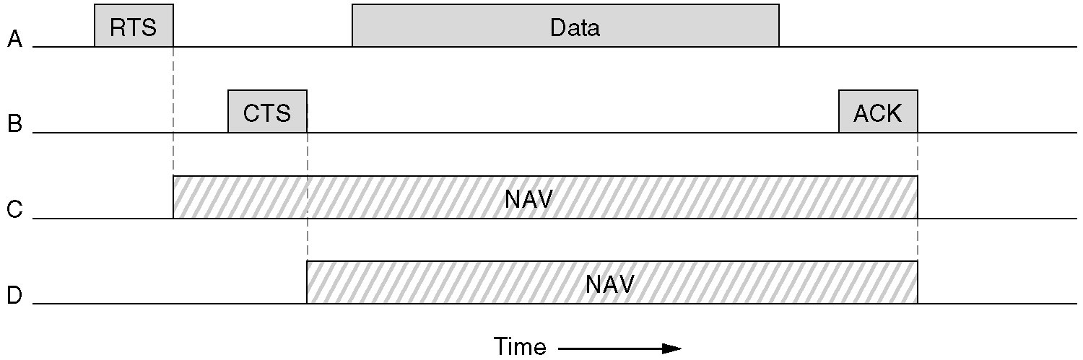
NAV (Network Allocation Vector)
Specifies the duration that an existing transmission wants to reserve.
Wireless Communications and Mobile Computing

Slide 14
DCF Example
RTS = Request-to-Send
RTS(50)
A
B
C
D
E
F
NAV = 50
Wireless Communications and Mobile Computing

Slide 15
DCF
CTS = Clear-to-Send
CTS(45)
A
B
C
D
E
F
NAV = 45
Wireless Communications and Mobile Computing

Slide 16
DCF
DATA packet follows CTS.
DATA
A
B
C
D
E
F
Wireless Communications and Mobile Computing

Slide 17
DCF
Successful data reception acknowledged using ACK.
ACK
A
B
C
D
E
F
Wireless Communications and Mobile Computing

Slide 18
Questions
How hidden terminal problem is solved?
  RTS/CTS
How is the collision probability?
  Minimum and maximum CW values
  DIFS and SIFS
  Backoff interval
  Retransmission limit
  Modeling: G. Bianchi (JSAC 2000)
    Mostly referred (>1000 references)
Wireless Communications and Mobile Computing

Slide 19
802.11 frame: addressing
2
2
6
6
6
2
6
0 - 2312
4
frame
control
duration
address
1
address
2
address
3
seq
control
address
4
payload
CRC
Address 4: used only in ad hoc mode
Address 1: MAC address
of wireless host or AP
to receive this frame
Address 3: MAC address
of router interface to which AP is attached
Address 2: MAC address
of wireless host or AP
transmitting this frame
Wireless Communications and Mobile Computing

Slide 20
802.11 frame: addressing
Internet
H1
R1
router
AP
R1 MAC addr AP MAC addr
dest. address
source address
802.3 frame
AP MAC addr H1 MAC addr R1 MAC addr
address 1
address 2
address 3
802.11 frame
Wireless Communications and Mobile Computing

Slide 21
802.11 frame: more
frame seq #
(for reliable ARQ)
duration of reserved
transmission time (RTS/CTS)
2
2
6
6
6
2
6
0 - 2312
4
frame
control
duration
address
1
address
2
address
3
seq
control
address
4
payload
CRC
2
2
4
1
1
1
1
1
1
1
1
Protocol
version
Type
Subtype
To
AP
From
AP
More
frag
Retry
Power
mgt
More
data
WEP
Rsvd
frame type
(RTS, CTS, ACK, data)
Wireless Communications and Mobile Computing

Slide 22
Questions
Is DCF fair?
  DFS by N. Vaidya (MobiCom 2000)
Can IEEE 802.11 provide QoS?
  EDCF (IEEE 802.11e)
  Many other approaches
    H. Zhu (Wireless Communications 2004)
Wireless Communications and Mobile Computing

